Slide 1
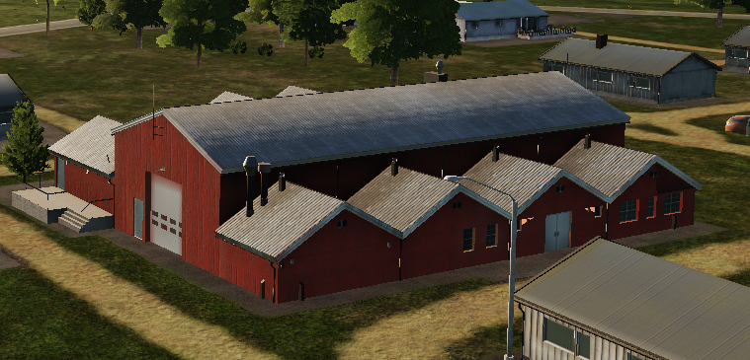
 | 500 IBS | 1000 IBS | 2000 IBS
1x Bomb
2x Bombs
4x Bombs

Slide 2
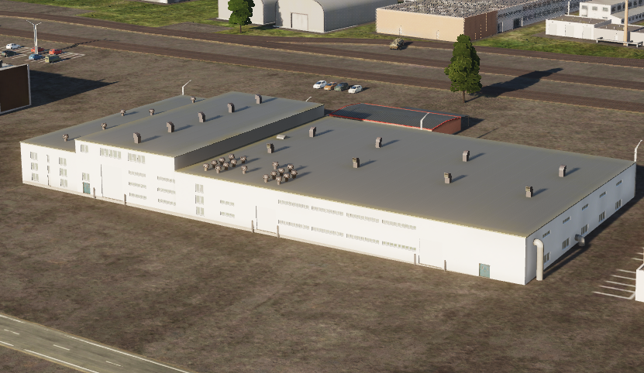
 | 500 IBS | 1000 IBS | 2000 IBS
1x Bomb
2x Bombs
4x Bombs
 | 500 IBS | 1000 IBS | 2000 IBS
1x Bomb
2x Bombs
4x Bombs

Slide 3
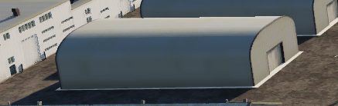
 | 500 IBS | 1000 IBS | 2000 IBS
1x Bomb
2x Bombs
4x Bombs

Slide 4
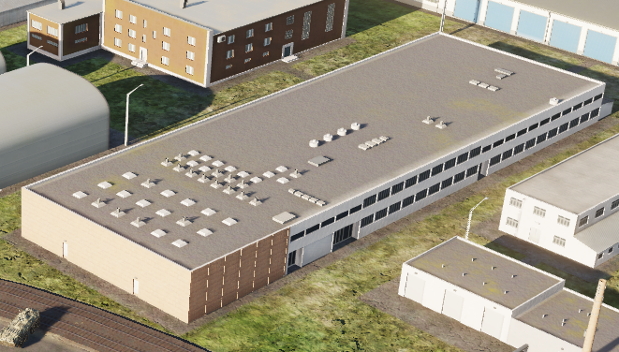
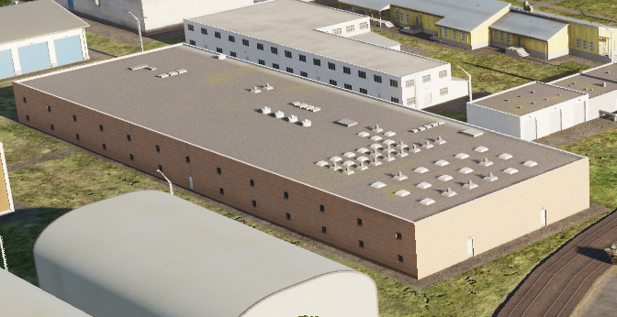
 | 500 IBS | 1000 IBS | 2000 IBS
1x Bomb
2x Bombs
4x Bombs

Slide 5
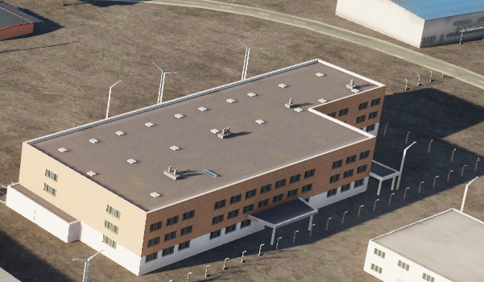
 | 500 IBS | 1000 IBS | 2000 IBS
1x Bomb
2x Bombs
4x Bombs

Slide 6
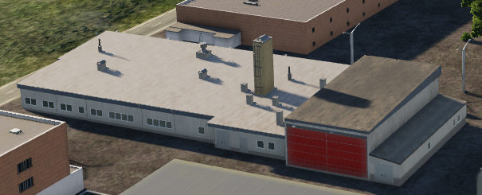
 | 500 IBS | 1000 IBS | 2000 IBS
1x Bomb
2x Bombs
4x Bombs

Slide 7
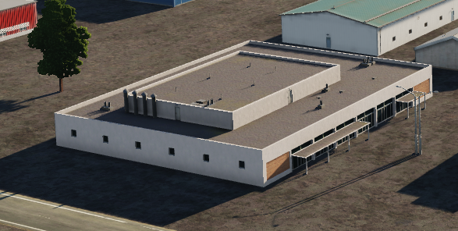
 | 500 IBS | 1000 IBS | 2000 IBS
1x Bomb
2x Bombs
4x Bombs

Slide 8
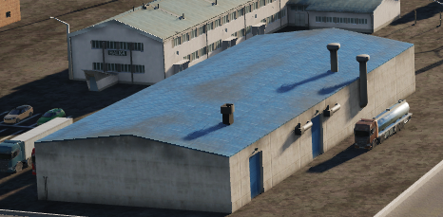
 | 500 IBS | 1000 IBS | 2000 IBS
1x Bomb
2x Bombs
4x Bombs

Slide 9
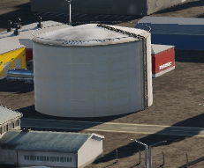
 | 500 IBS | 1000 IBS | 2000 IBS
1x Bomb
2x Bombs
4x Bombs

Slide 10
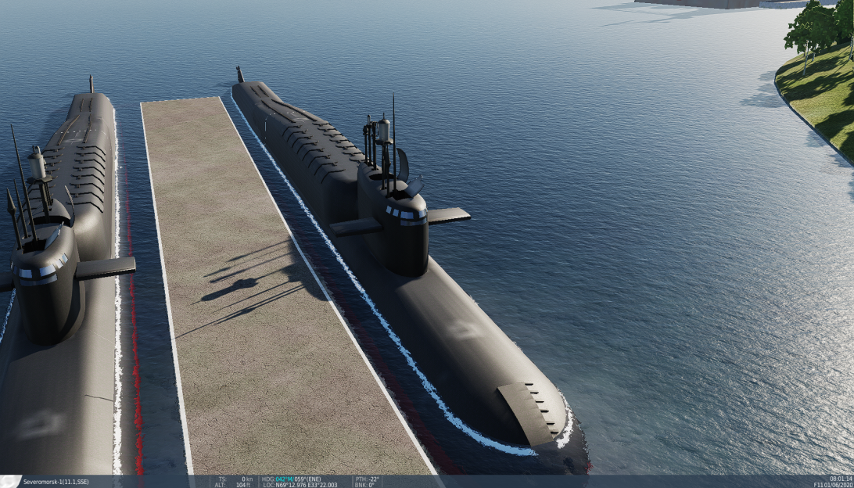
 | 500 IBS | 1000 IBS | 2000 IBS
1x Bomb
2x Bombs
4x Bombs
NOTE: Also destructable with 20mm cannon

Slide 11
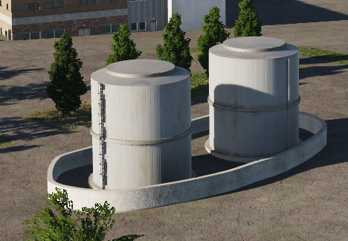
 | 500 IBS | 1000 IBS | 2000 IBS
1x Bomb
2x Bombs
4x Bombs

Slide 12
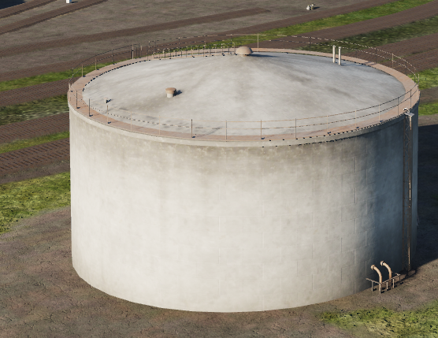
 | 500 IBS | 1000 IBS | 2000 IBS
1x Bomb
2x Bombs
4x Bombs

Slide 13
VERIFIED after this

Slide 14
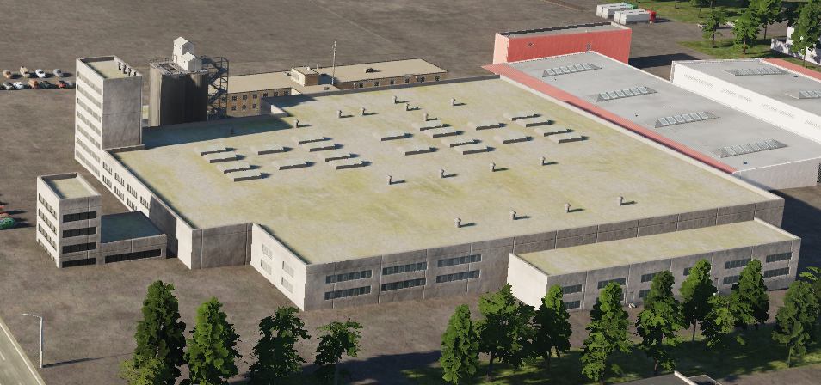
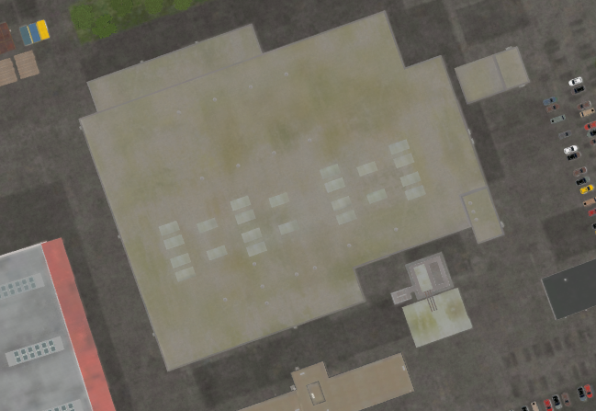
 | 500 IBS | 1000 IBS | 2000 IBS
1x Bomb
2x Bombs
4x Bombs

Slide 15
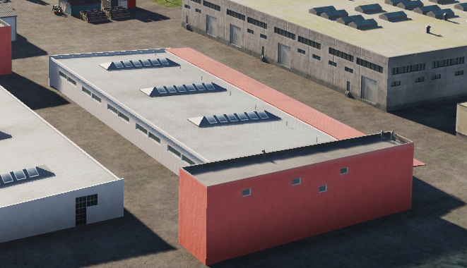
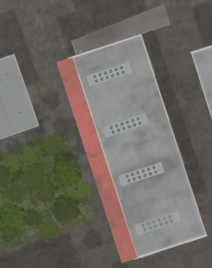
 | 500 IBS | 1000 IBS | 2000 IBS
1x Bomb
2x Bombs
4x Bombs

Slide 16
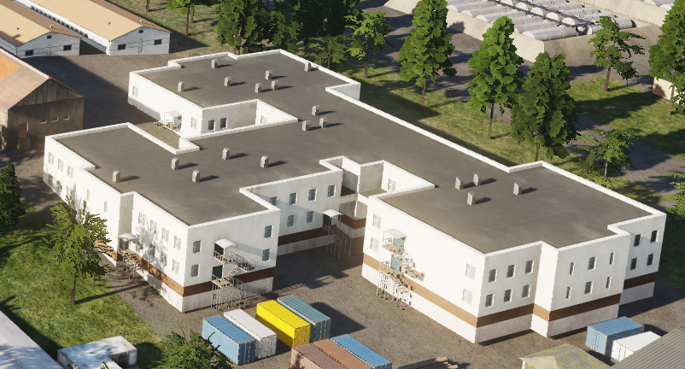
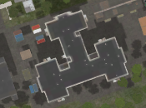
 | 500 IBS | 1000 IBS | 2000 IBS
1x Bomb
2x Bombs
4x Bombs

Slide 17
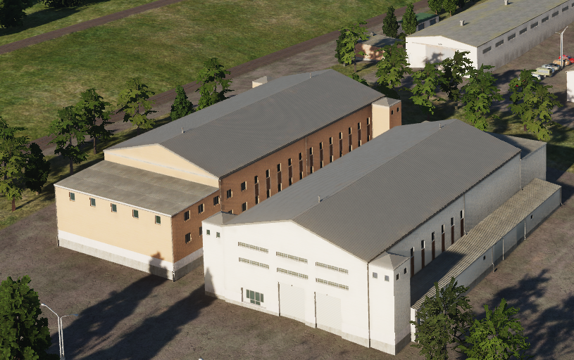
 | 500 IBS | 1000 IBS | 2000 IBS
1x Bomb
2x Bombs
4x Bombs
Same building, just different colors
Gives ruins

Slide 18
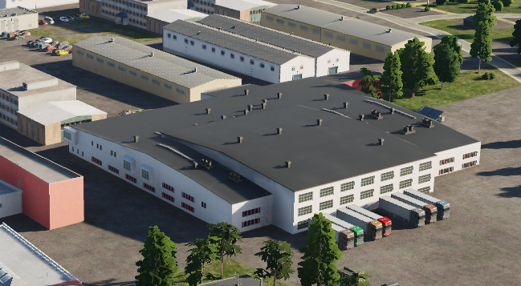
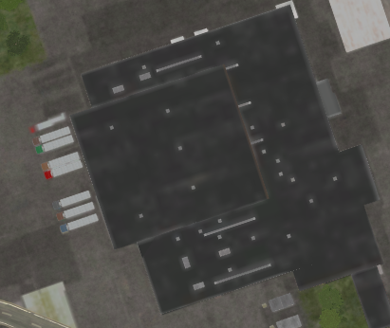
 | 500 IBS | 1000 IBS | 2000 IBS
1x Bomb
2x Bombs
4x Bombs
When destroyed, will be completely wiped from map, and gives not ruins

Slide 19
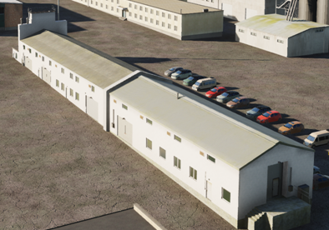
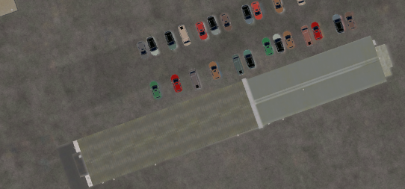
 | 500 IBS | 1000 IBS | 2000 IBS
1x Bomb
2x Bombs
4x Bombs
Gives ruins

Slide 20
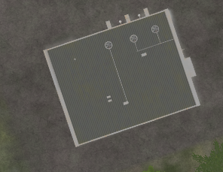
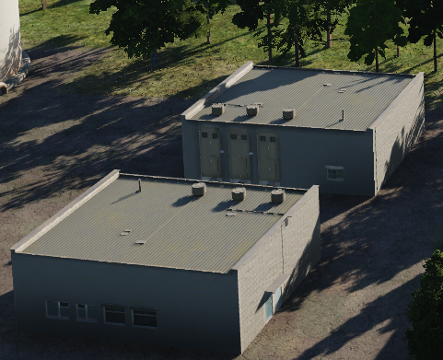
 | 500 IBS | 1000 IBS | 2000 IBS
1x Bomb
2x Bombs
4x Bombs
Gives ruins

Slide 21
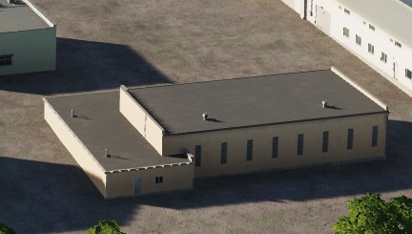
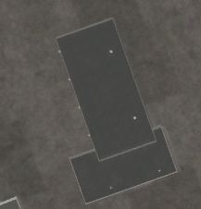
 | 500 IBS | 1000 IBS | 2000 IBS
1x Bomb
2x Bombs
4x Bombs

Slide 22
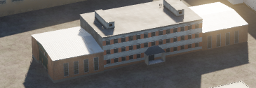
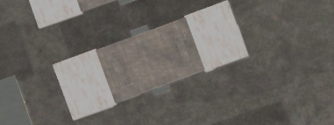
 | 500 IBS | 1000 IBS | 2000 IBS
1x Bomb
2x Bombs
4x Bombs
Gives ruins

Slide 23
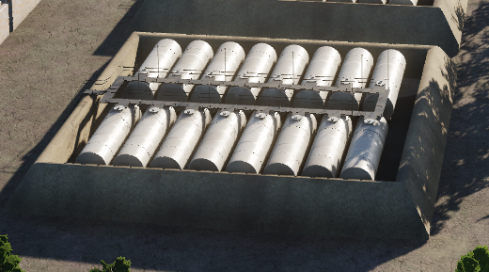
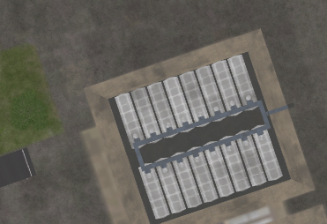
 | 500 IBS | 1000 IBS | 2000 IBS
1x Bomb
2x Bombs
4x Bombs
Gives ruins

Slide 24
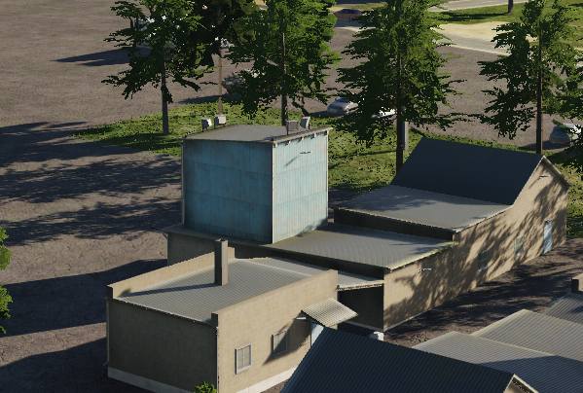
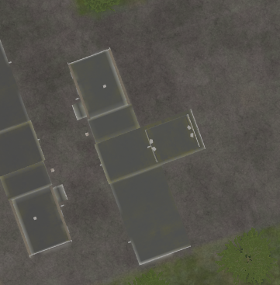
 | 500 IBS | 1000 IBS | 2000 IBS
1x Bomb
2x Bombs
4x Bombs
Gives ruins

Slide 25
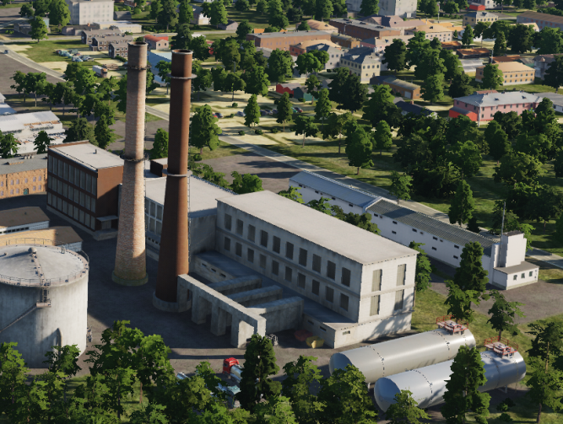
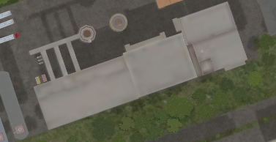
 | 500 IBS | 1000 IBS | 2000 IBS
1x Bomb
2x Bombs
4x Bombs
When destroyed, will be completely wiped from map, and gives not ruins

Slide 26
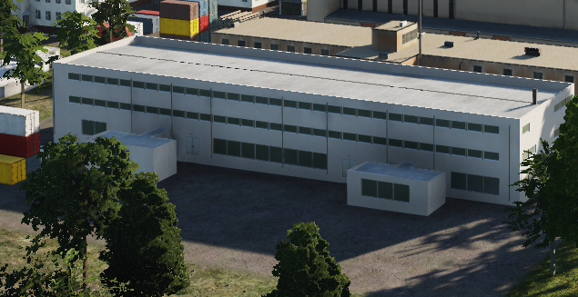
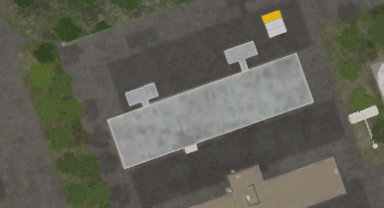
 | 500 IBS | 1000 IBS | 2000 IBS
1x Bomb
2x Bombs
4x Bombs
When destroyed, will be completely wiped from map, and gives not ruins

Slide 27
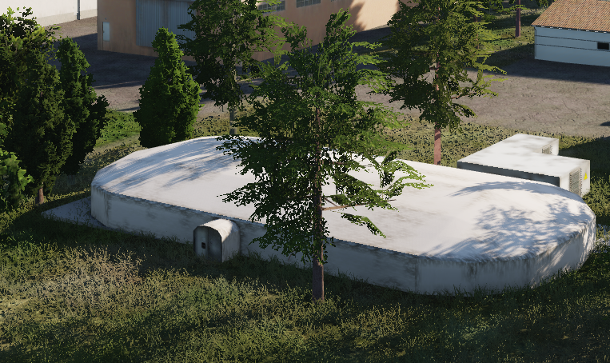
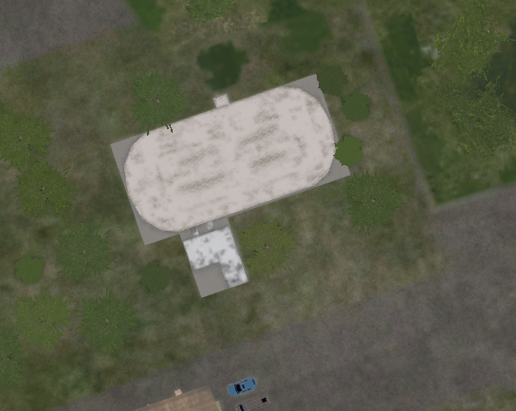
 | 500 IBS | 1000 IBS | 2000 IBS
1x Bomb
2x Bombs
4x Bombs
When destroyed, will be completely wiped from map, and gives not ruins

Slide 28
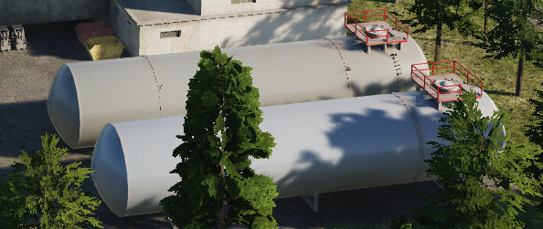
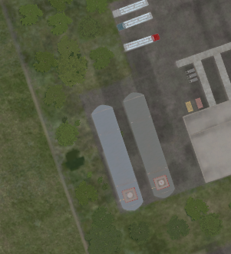
 | 500 IBS | 1000 IBS | 2000 IBS
1x Bomb
2x Bombs
4x Bombs
Gives ruins

Slide 29
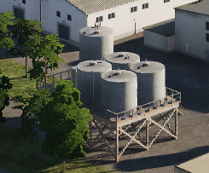
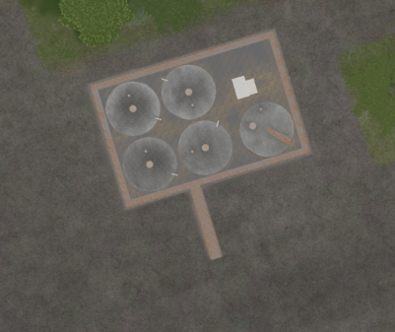
 | 500 IBS | 1000 IBS | 2000 IBS
1x Bomb
2x Bombs
4x Bombs
Gives ruins

Slide 30
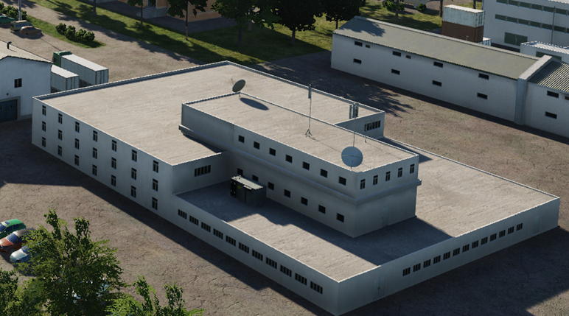
 | 500 IBS | 1000 IBS | 2000 IBS
1x Bomb
2x Bombs
4x Bombs
WIP - not tested

Slide 31
 | 500 IBS | 1000 IBS | 2000 IBS
1x Bomb
2x Bombs
4x Bombs

Slide 32
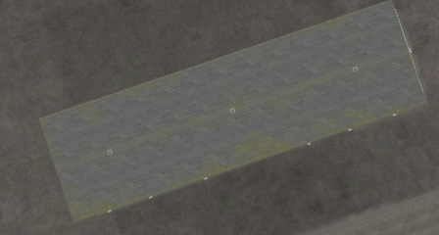
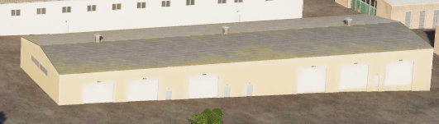
 | 500 IBS | 1000 IBS | 2000 IBS
1x Bomb
2x Bombs
4x Bombs
INDESTRUCTABLE

Slide 33
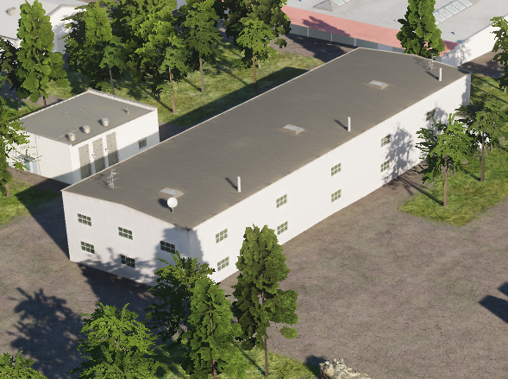
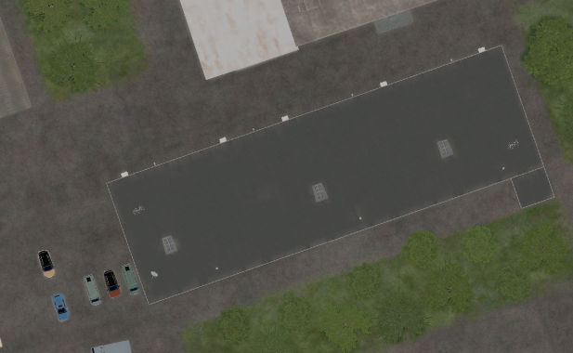
 | 500 IBS | 1000 IBS | 2000 IBS
1x Bomb
2x Bombs
4x Bombs
INDESTRUCTABLE

Slide 34
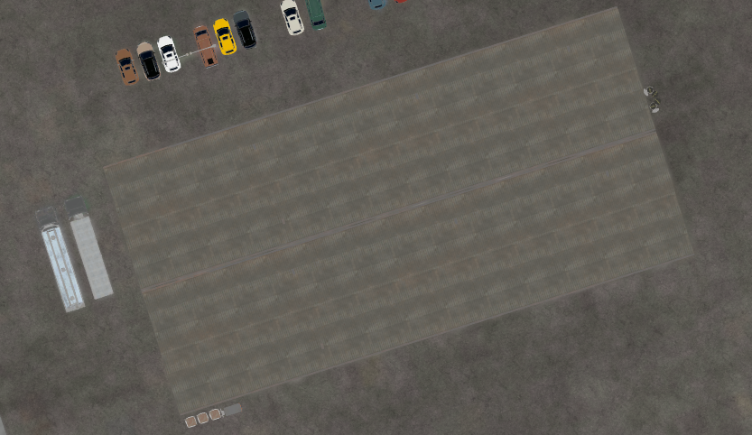

 | 500 IBS | 1000 IBS | 2000 IBS
1x Bomb
2x Bombs
4x Bombs
INDESTRUCTABLE

Slide 35


 | 500 IBS | 1000 IBS | 2000 IBS
1x Bomb
2x Bombs
4x Bombs
INDESTRUCTABLE

Slide 36


 | 500 IBS | 1000 IBS | 2000 IBS
1x Bomb
2x Bombs
4x Bombs
INDESTRUCTABLE

